Slide 1
Computer Science Exploration
Where we have fun learning about computer science!

Slide 2
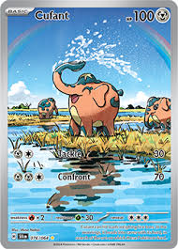
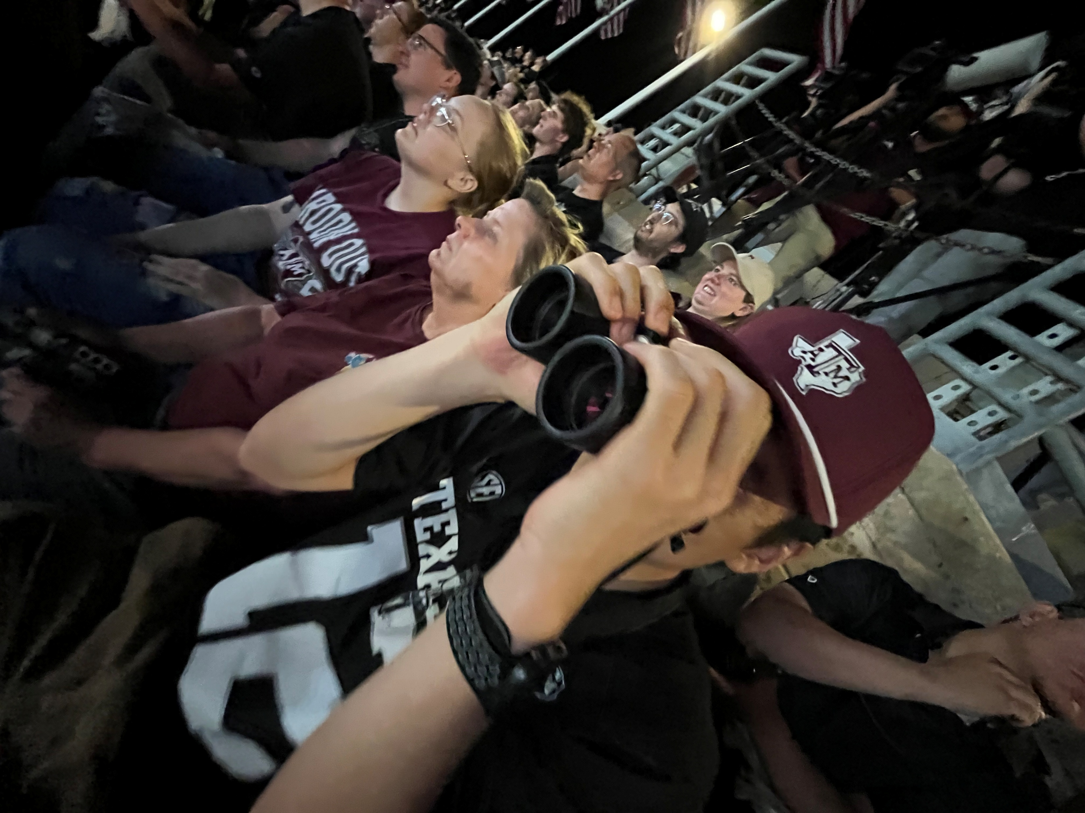
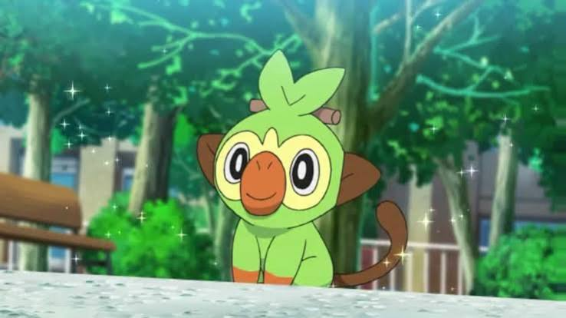
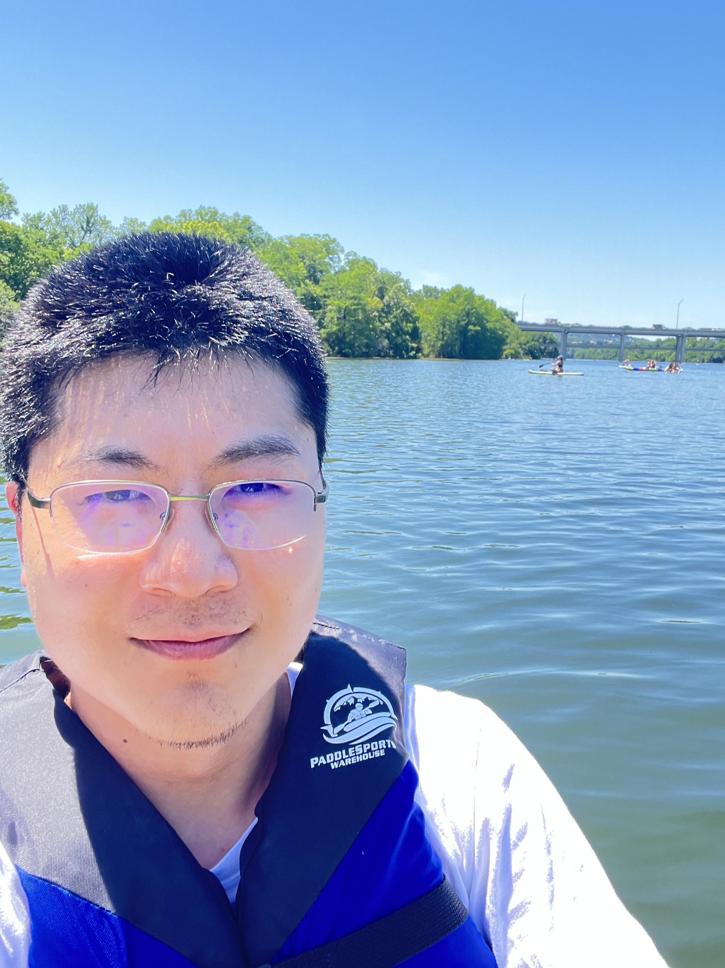
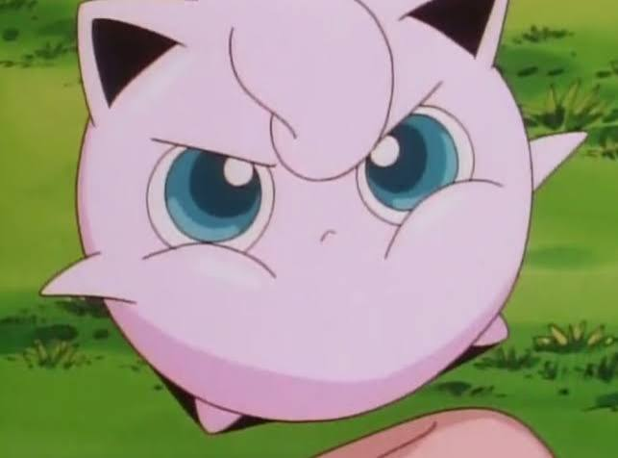
About Me
Jerry Li
Associate Software Engineer, Collins Aerospace
B.S. Computer Science
Texas A&M University, 2024
Hobbies: College football, clarinet and orchestra, chess drama
Favorite Pokemon: Jigglypuff, Grookey, Cufant
Favorite things to do in Iowa: Hang out at the library, visit Iowa City

Slide 3
Rules
No one is too young or too old to learn computing.
Treat others as you would like to be treated.
Respect the equipment provided to you.
Have fun!

Slide 4
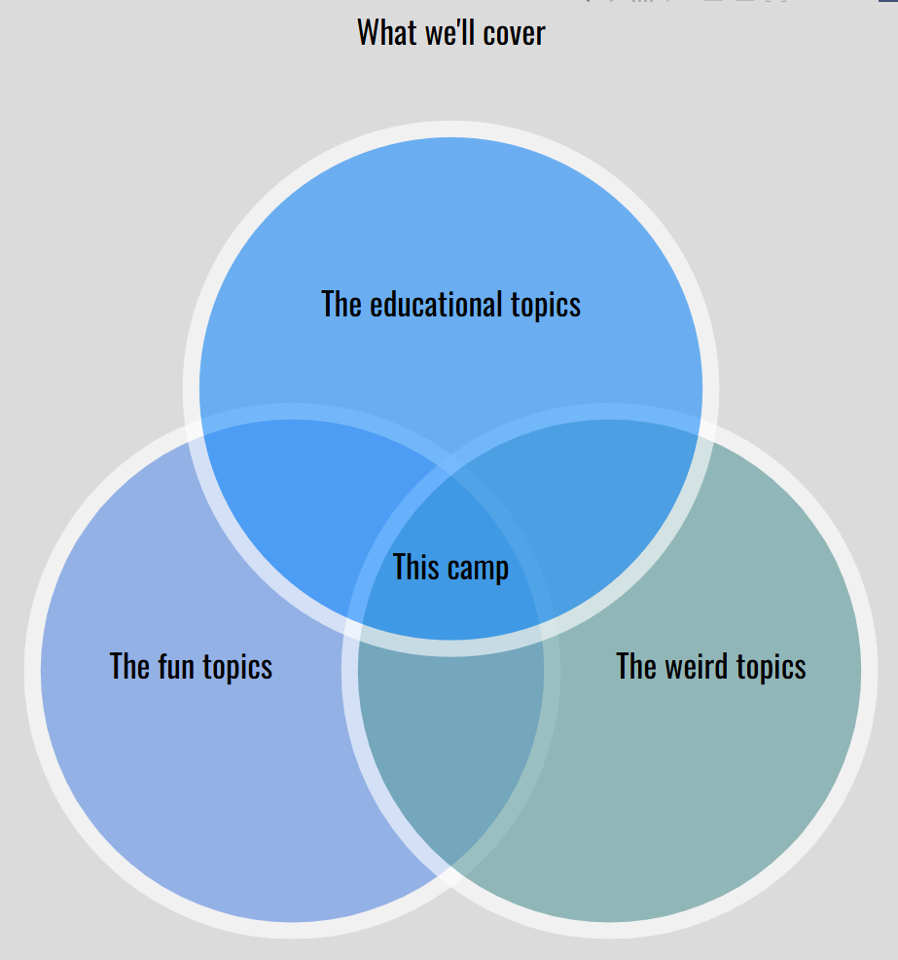
Goal is for you to find computer science relevant, thought-provoking, and FUN!!

Slide 5
Without further ado…
Go here!
https://github.com/jerryli65/HPL-CompSciExploration/tree/main

